Slide 1
Regularization

Slide 2
Regularization
Overfitting
Cost function
Regularized linear regression
Regularized logistic regression

Slide 3
Regularization
Overfitting
Cost function
Regularized linear regression
Regularized logistic regression

Slide 4

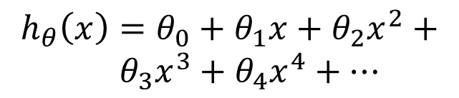

Example: Linear regression
Price ($) in 1000’s
Price ($) in 1000’s
Price ($) in 1000’s
Size in feet^2
Size in feet^2
Size in feet^2
$$h_{θ}\left(x\right)=θ_{0}+θ_{1}x$$
$$h_{θ}\left(x\right)=θ_{0}+θ_{1}x+θ_{2}x^{2}$$
$$h_{θ}\left(x\right)=θ_{0}+θ_{1}x+θ_{2}x^{2}+ \\ { θ}_{3}x^{3}+θ_{4}x^{4}+⋯$$
Underfitting
Just right
Overfitting

Slide 5
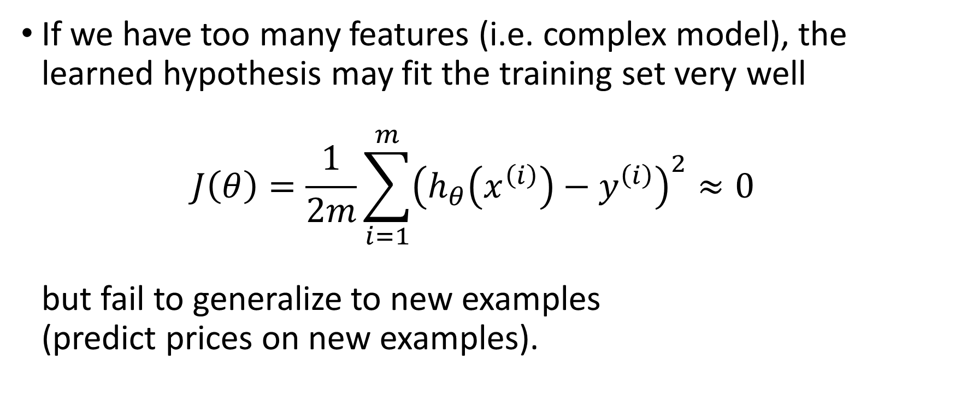
Overfitting
If we have too many features (i.e. complex model), the learned hypothesis may fit the training set very well $J\left(θ\right)=\frac{1}{2m}\sum_{i=1}^{m}{{\left(h_{θ}\left(x^{\left(i\right)}\right)−y^{\left(i\right)}\right)}^{2}}≈0$ but fail to generalize to new examples (predict prices on new examples).

Slide 6
Example: Linear regression
Price ($) in 1000’s
Price ($) in 1000’s
Price ($) in 1000’s
Size in feet^2
Size in feet^2
Size in feet^2
$$h_{θ}\left(x\right)=θ_{0}+θ_{1}x$$
$$h_{θ}\left(x\right)=θ_{0}+θ_{1}x+θ_{2}x^{2}$$
$$h_{θ}\left(x\right)=θ_{0}+θ_{1}x+θ_{2}x^{2}+ \\ { θ}_{3}x^{3}+θ_{4}x^{4}+⋯$$
Underfitting
Just right
Overfitting
High bias
High variance

Slide 7
Bias-Variance Tradeoff
Bias: difference between what you expect to learn and truth
Measures how well you expect to represent true solution
Decreases with more complex model
Variance: difference between what you expect to learn and what you learn from a particular dataset
Measures how sensitive learner is to specific dataset
Increases with more complex model

Slide 8

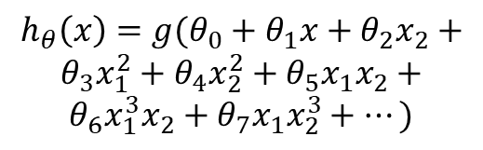
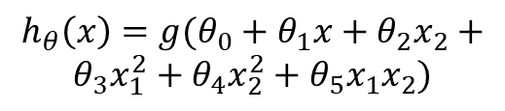
Overfitting
Age
Age
Age
Tumor Size
Tumor Size
Tumor Size
$$h_{θ}\left(x\right)={g(θ}_{0}+θ_{1}x+θ_{2}x_{2})$$
$$h_{θ}\left(x\right)={g(θ}_{0}+θ_{1}x+θ_{2}x_{2}+$$
$$θ_{3}x_{1}^{2}+θ_{4}x_{2}^{2}+θ_{5}x_{1}x_{2})$$
$$h_{θ}\left(x\right)={g(θ}_{0}+θ_{1}x+θ_{2}x_{2}+$$
$$θ_{3}x_{1}^{2}+θ_{4}x_{2}^{2}+θ_{5}x_{1}x_{2}+$$
$$θ_{6}x_{1}^{3}x_{2}+θ_{7}x_{1}x_{2}^{3}+⋯)$$
Underfitting
Overfitting

Slide 9

Addressing overfitting
Price ($) in 1000’s
$x_{1}=$ size of house
$x_{2}=$no. of bedrooms
$x_{3}=$no. of floors
$x_{4}=$age of house
$x_{5}=$average income in neighborhood
$x_{6}=$kitchen size
$⋮$
$x_{100}$
Size in feet^2

Slide 10
Addressing overfitting
How do we deal with this?
1) Reduce number of features
Manually select which features to keep
But, in reducing the number of features we lose some information
Ideally select those features which minimize data loss, but even so, some info is lost
2) Regularization
Keep all features, but reduce magnitude of parameters θ
Works well when we have a lot of features, each of which contributes a bit to predicting y

Slide 11
Regularization
Overfitting
Cost function
Regularized linear regression
Regularized logistic regression

Slide 12


Intuition
Price ($) in 1000’s
Price ($) in 1000’s
Suppose we penalize and make $θ_{3},θ_{4}$really small.
$$\min_{θ}{J\left(θ\right)=\frac{1}{2m}\sum_{i=1}^{m}{{\left(h_{θ}\left(x^{\left(i\right)}\right)−y^{\left(i\right)}\right)}^{2}}+1000 θ_{3}^{2}+1000{ θ}_{4}^{2}}$$
Size in feet^2
Size in feet^2
$$h_{θ}\left(x\right)=θ_{0}+θ_{1}x+θ_{2}x^{2}$$
$$h_{θ}\left(x\right)=θ_{0}+θ_{1}x+θ_{2}x^{2}+θ_{3}x^{3}+θ_{4}x^{4}$$

Slide 13
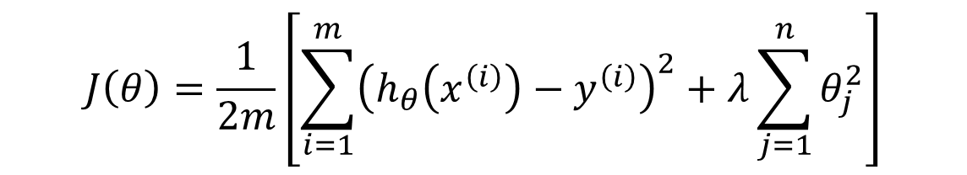
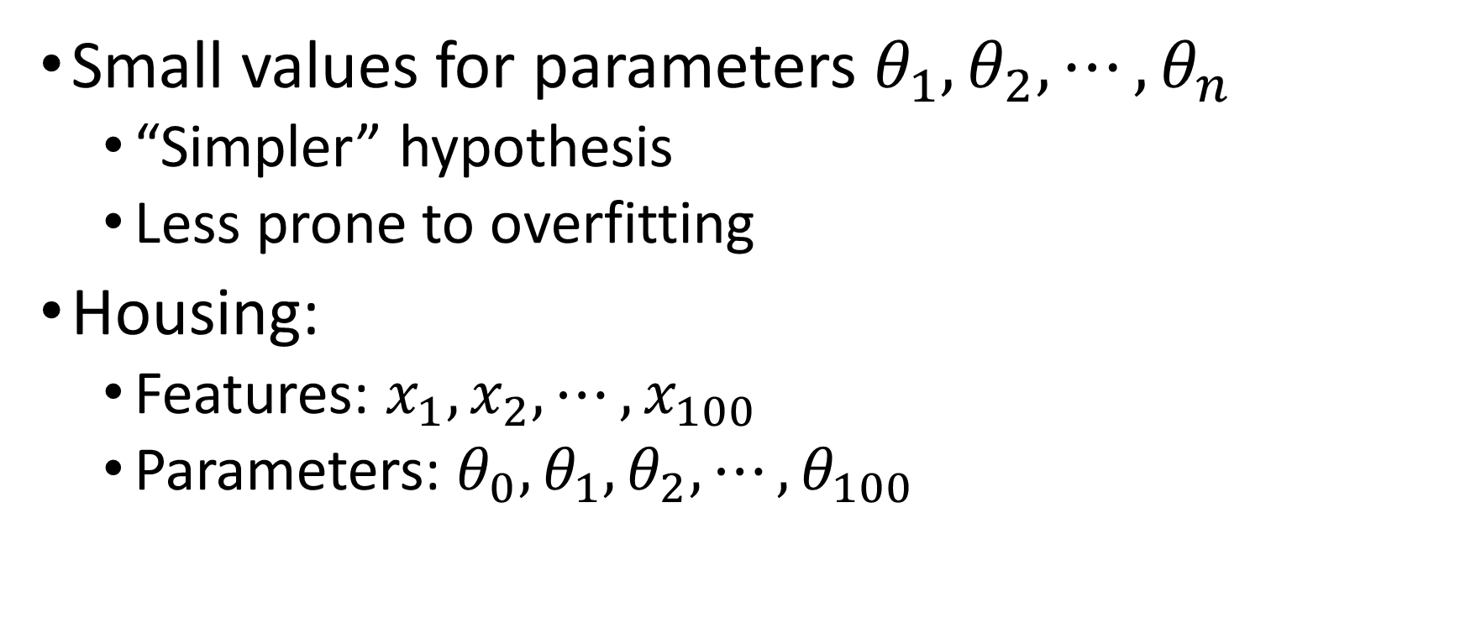
Regularization.
Small values for parameters $θ_{1}, θ_{2}, ⋯, θ_{n}$
“Simpler” hypothesis
Less prone to overfitting
Housing:
Features: $x_{1}, x_{2}, ⋯, x_{100}$
Parameters: ${θ_{0},θ}_{1}, θ_{2}, ⋯, θ_{100}$
$$J\left(θ\right)=\frac{1}{2m}\left[\sum_{i=1}^{m}{{\left(h_{θ}\left(x^{\left(i\right)}\right)−y^{\left(i\right)}\right)}^{2}}+λ\sum_{j=1}^{n}{θ_{j}^{2}}\right]$$

Slide 14
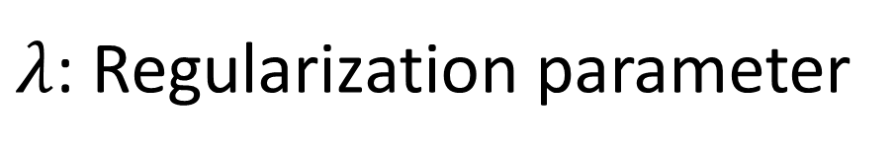
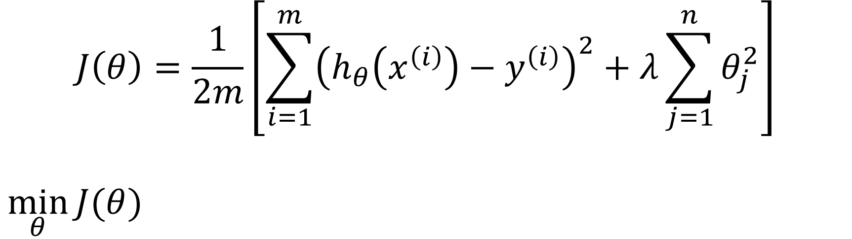
Regularization
$$J\left(θ\right)=\frac{1}{2m}\left[\sum_{i=1}^{m}{{\left(h_{θ}\left(x^{\left(i\right)}\right)−y^{\left(i\right)}\right)}^{2}}+λ\sum_{j=1}^{n}{θ_{j}^{2}}\right]$$
$$\min_{θ}{J(θ)}$$
Price ($) in 1000’s
$λ$: Regularization parameter
Size in feet^2

Slide 15
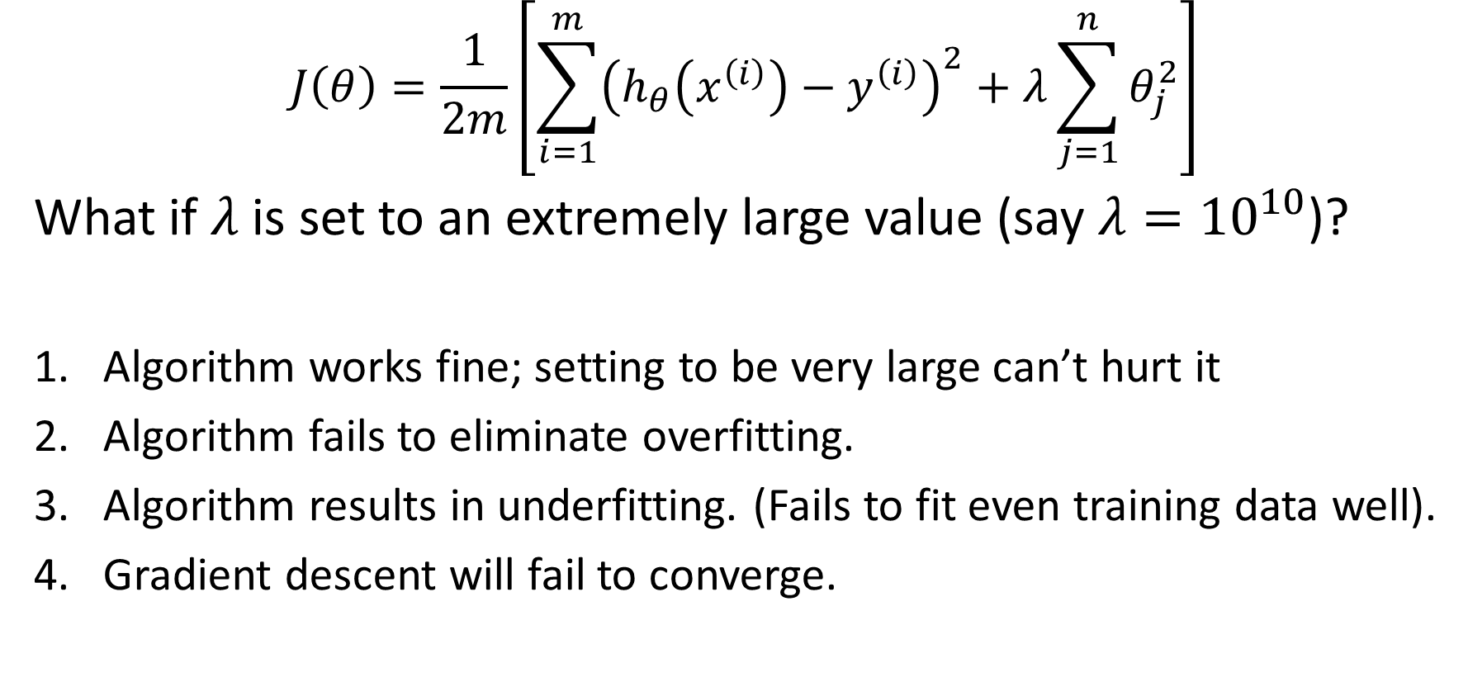
Question
$$J\left(θ\right)=\frac{1}{2m}\left[\sum_{i=1}^{m}{{\left(h_{θ}\left(x^{\left(i\right)}\right)−y^{\left(i\right)}\right)}^{2}}+λ\sum_{j=1}^{n}{θ_{j}^{2}}\right]$$
What if $λ$is set to an extremely large value (say $λ={10}^{10}$)?
Algorithm works fine; setting to be very large can’t hurt it
Algorithm fails to eliminate overfitting.
Algorithm results in underfitting. (Fails to fit even training data well).
Gradient descent will fail to converge.

Slide 16

Question
$$J\left(θ\right)=\frac{1}{2m}\left[\sum_{i=1}^{m}{{\left(h_{θ}\left(x^{\left(i\right)}\right)−y^{\left(i\right)}\right)}^{2}}+λ\sum_{j=1}^{n}{θ_{j}^{2}}\right]$$
What if $λ$is set to an extremely large value (say $λ={10}^{10}$)?
Price ($) in 1000’s
Size in feet^2
$$h_{θ}\left(x\right)=θ_{0}+θ_{1}x_{1}+θ_{2}x_{2}+…+θ_{n}x_{n}=θ^{⊤}x$$

Slide 17
Regularization
Overfitting
Cost function
Regularized linear regression
Regularized logistic regression

Slide 18
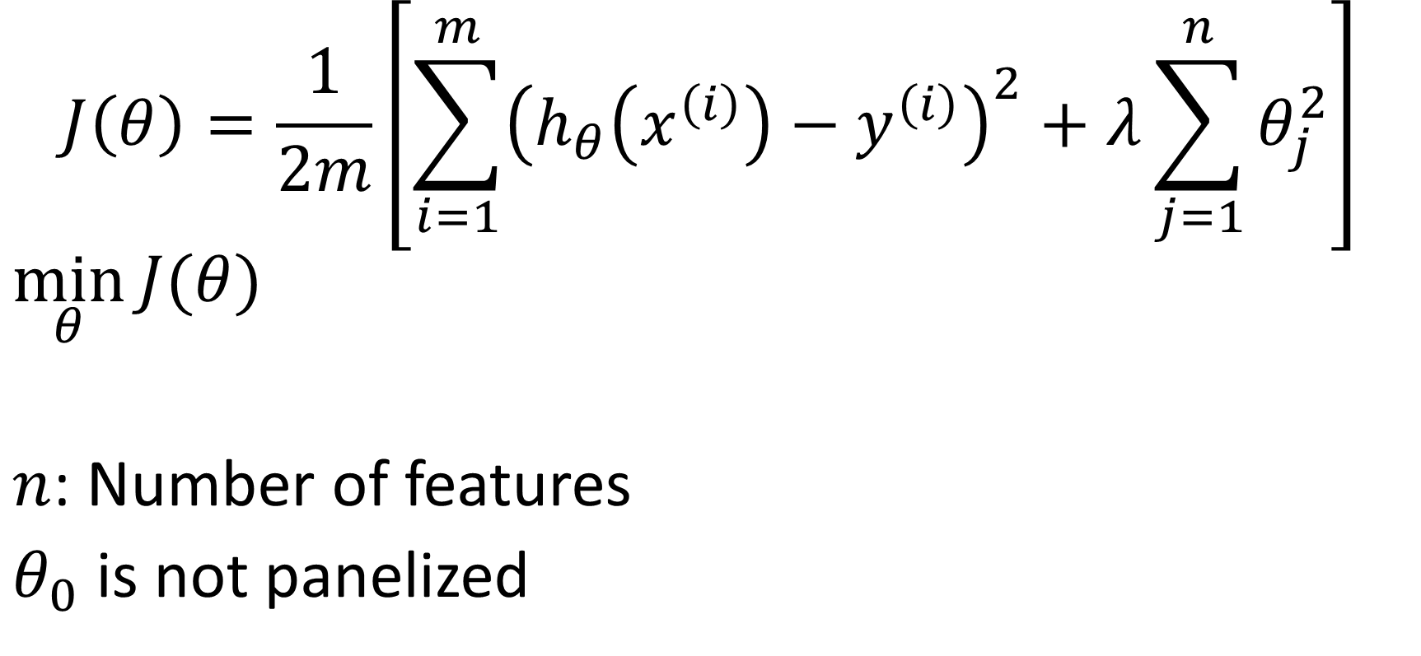
Regularized linear regression
$$J\left(θ\right)=\frac{1}{2m}\left[\sum_{i=1}^{m}{{\left(h_{θ}\left(x^{\left(i\right)}\right)−y^{\left(i\right)}\right)}^{2}}+λ\sum_{j=1}^{n}{θ_{j}^{2}}\right]$$
$$\min_{θ}{J(θ)}$$
$n$: Number of features
$θ_{0}$ is not panelized

Slide 19

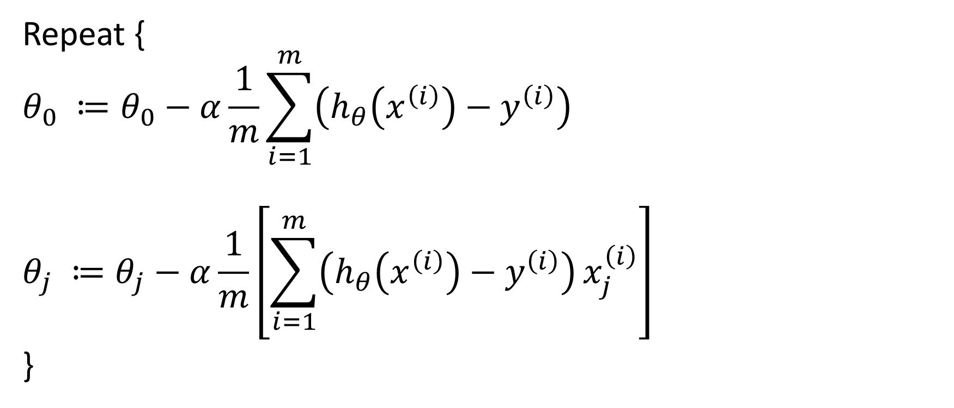

Gradient descent (Previously)
Repeat {
$$θ_{0} ≔θ_{0}−α\frac{1}{m}\sum_{i=1}^{m}{\left(h_{θ}\left(x^{\left(i\right)}\right)−y^{\left(i\right)}\right)}$$
$$θ_{j} ≔θ_{j}−α\frac{1}{m}\left[\sum_{i=1}^{m}{\left(h_{θ}\left(x^{\left(i\right)}\right)−y^{\left(i\right)}\right)}x_{j}^{\left(i\right)}\right]$$
}
$$(j=0)$$
$$(j=1, 2, 3,⋯,n)$$

Slide 20
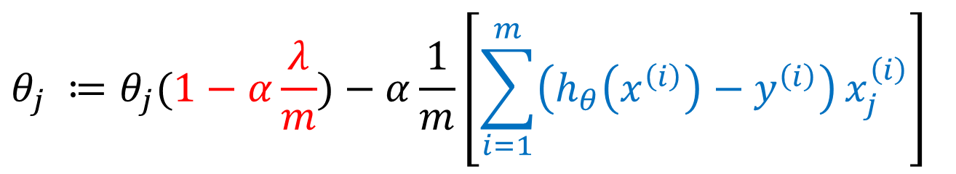
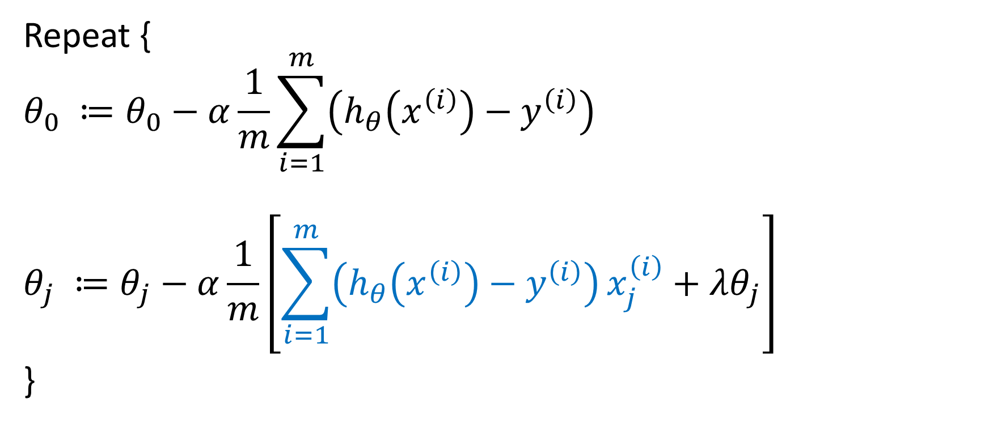
Gradient descent (Regularized)
Repeat {
$$θ_{0} ≔θ_{0}−α\frac{1}{m}\sum_{i=1}^{m}{\left(h_{θ}\left(x^{\left(i\right)}\right)−y^{\left(i\right)}\right)}$$
$$θ_{j} ≔θ_{j}−α\frac{1}{m}\left[\sum_{i=1}^{m}{\left(h_{θ}\left(x^{\left(i\right)}\right)−y^{\left(i\right)}\right)}x_{j}^{\left(i\right)}+λθ_{j}\right]$$
}
$$θ_{j} ≔θ_{j}(1−α\frac{λ}{m})−α\frac{1}{m}\left[\sum_{i=1}^{m}{\left(h_{θ}\left(x^{\left(i\right)}\right)−y^{\left(i\right)}\right)}x_{j}^{\left(i\right)}\right]$$

Slide 21
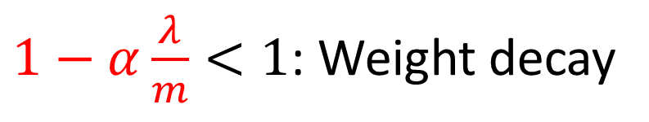
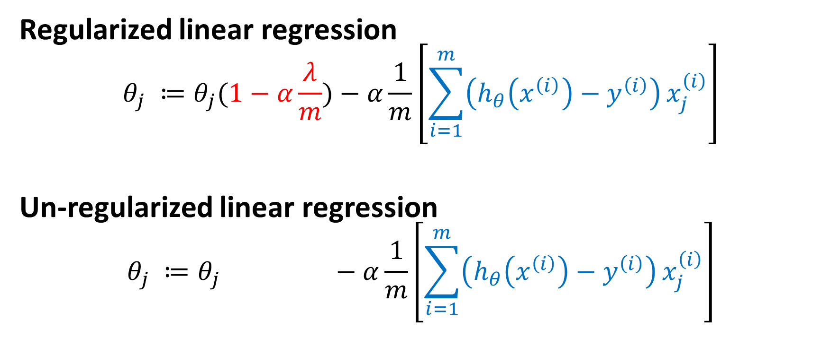
Comparison
$1−α\frac{λ}{m}<1$: Weight decay
Regularized linear regression
$$θ_{j} ≔θ_{j}(1−α\frac{λ}{m})−α\frac{1}{m}\left[\sum_{i=1}^{m}{\left(h_{θ}\left(x^{\left(i\right)}\right)−y^{\left(i\right)}\right)}x_{j}^{\left(i\right)}\right]$$
Un-regularized linear regression
$$θ_{j} ≔θ_{j} −α\frac{1}{m}\left[\sum_{i=1}^{m}{\left(h_{θ}\left(x^{\left(i\right)}\right)−y^{\left(i\right)}\right)}x_{j}^{\left(i\right)}\right]$$

Slide 22
Regularization
Overfitting
Cost function
Regularized linear regression
Regularized logistic regression

Slide 23
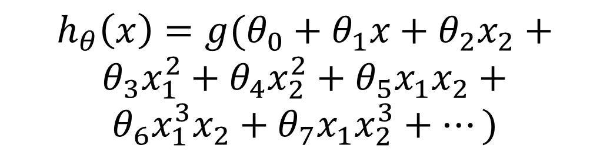

Regularized logistic regression
Cost function:
$$J\left(θ\right)=\frac{1}{m}\left[\sum_{i=1}^{m}{y^{\left(i\right)}\log{h_{θ}\left(x^{\left(i\right)}\right)}+(1−y^{\left(i\right)})\log\left(1−h_{θ}\left(x^{\left(i\right)}\right)\right)}+\frac{λ}{2}\sum_{j=1}^{n}{θ_{j}^{2}}\right]$$
$$h_{θ}\left(x\right)={g(θ}_{0}+θ_{1}x+θ_{2}x_{2}+$$
$$θ_{3}x_{1}^{2}+θ_{4}x_{2}^{2}+θ_{5}x_{1}x_{2}+$$
$$θ_{6}x_{1}^{3}x_{2}+θ_{7}x_{1}x_{2}^{3}+⋯)$$
Age
Tumor Size

Slide 24
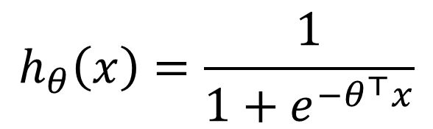
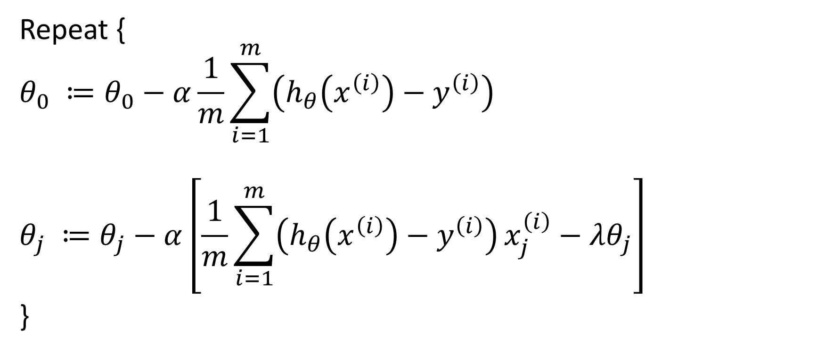

Gradient descent (Regularized)
Repeat {
$$θ_{0} ≔θ_{0}−α\frac{1}{m}\sum_{i=1}^{m}{\left(h_{θ}\left(x^{\left(i\right)}\right)−y^{\left(i\right)}\right)}$$
$$θ_{j} ≔θ_{j}−α\left[\frac{1}{m}\sum_{i=1}^{m}{\left(h_{θ}\left(x^{\left(i\right)}\right)−y^{\left(i\right)}\right)}x_{j}^{\left(i\right)}−λθ_{j}\right]$$
}
$$h_{θ}\left(x\right)=\frac{1}{1+e^{−θ^{⊤}x}}$$
$$\frac{∂}{∂θ_{j}}J(θ)$$

Slide 25
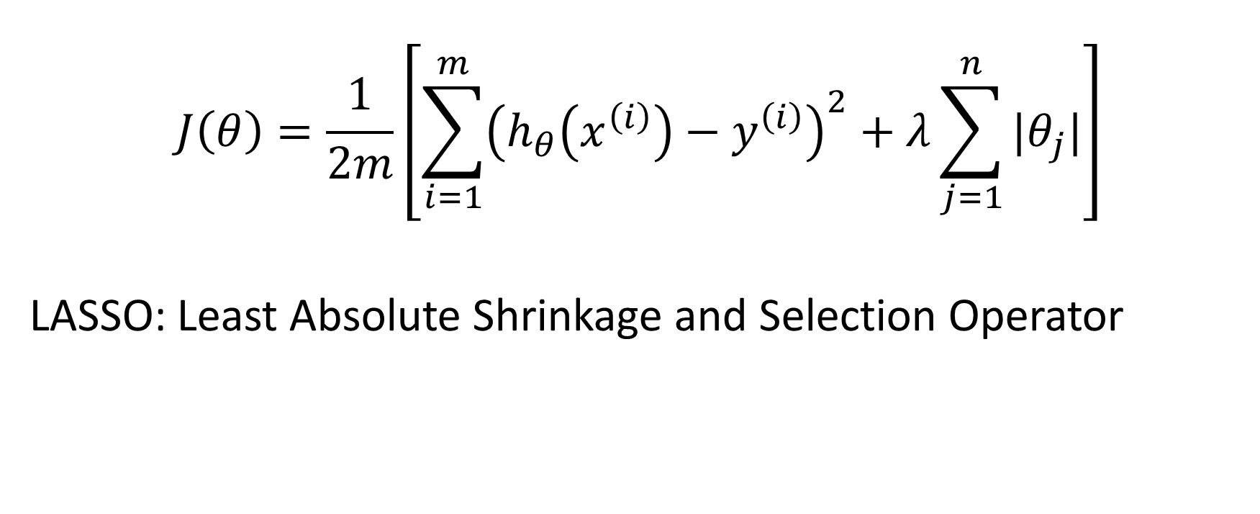
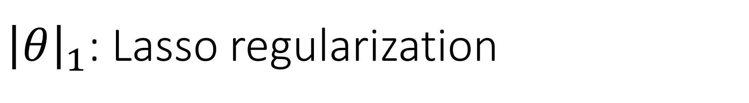
${\left|θ\right|}_{1}$: Lasso regularization
$$J\left(θ\right)=\frac{1}{2m}\left[\sum_{i=1}^{m}{{\left(h_{θ}\left(x^{\left(i\right)}\right)−y^{\left(i\right)}\right)}^{2}}+λ\sum_{j=1}^{n}{|θ_{j}|}\right]$$
LASSO: Least Absolute Shrinkage and Selection Operator

Slide 26
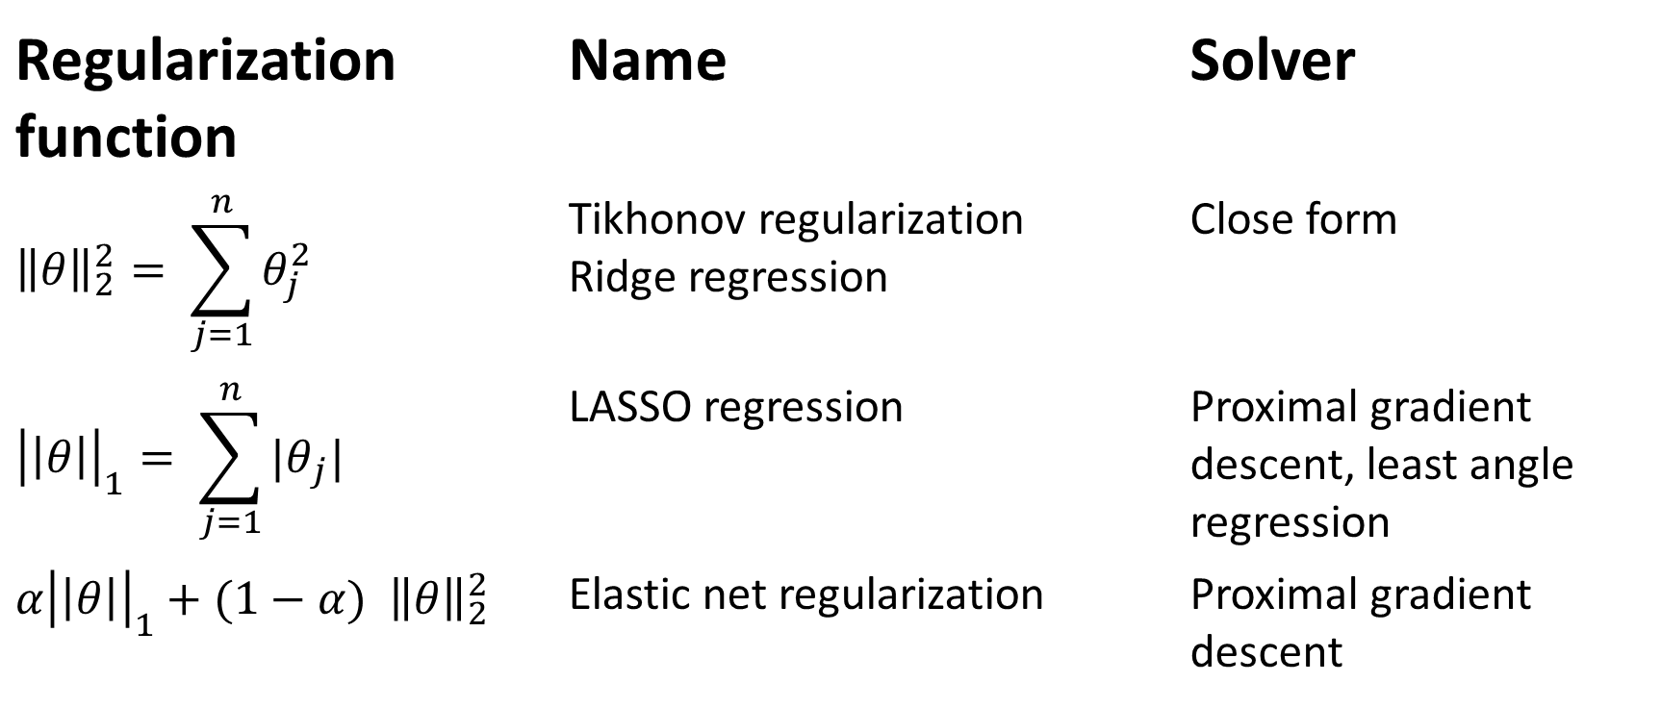
Terminology
Regularization function | Name | Solver
$${\left\|θ\right\|}_{2}^{2}= \sum_{j=1}^{n}{θ_{j}^{2}}$$ | Tikhonov regularization Ridge regression | Close form
$${\left|\left|θ\right|\right|}_{1}= \sum_{j=1}^{n}{{|θ}_{j}| }$$ | LASSO regression | Proximal gradient descent, least angle regression
$$α{\left|\left|θ\right|\right|}_{1}+(1−α){ \left\|θ\right\|}_{2}^{2}$$ | Elastic net regularization | Proximal gradient descent

Slide 27
Things to remember
Overfitting
Cost function
Regularized linear regression
Regularized logistic regression

